Slide 1
ICH M11: Clinical electronic Structured Harmonised Protocol (CeSHarP)
An Introduction to the Guideline, Template, and Technical Specification
Step 4
© ICH 2026
Step 4 documents
19 Nov 2025
© International Council for Harmonisation of Technical Requirements
for Pharmaceuticals for Human Use (ICH) 2026

Slide 2
Legal Notice
This presentation is protected by copyright and may, with the exception of the ICH logo, be used, reproduced, incorporated into other works, adapted, modified, translated or distributed under a public license provided that ICH's copyright in the presentation is acknowledged at all times. In case of any adaption, modification or translation of the presentation, reasonable steps must be taken to clearly label, demarcate or otherwise identify that changes were made to or based on the original presentation. Any impression that the adaption, modification or translation of the original presentation is endorsed or sponsored by the ICH must be avoided.
The presentation is provided "as is" without warranty of any kind. In no event shall the ICH or the authors of the original presentation be liable for any claim, damages or other liability arising from the use of the presentation.
The above-mentioned permissions do not apply to content supplied by third parties. Therefore, for documents where the copyright vests in a third party, permission for reproduction must be obtained from this copyright holder.

Slide 3
Background
The ICH M11 Guideline, ICH M11 Technical Specification and ICH M11 Template documents have been signed off as Step 4 document (19 November 2025) to be implemented by the ICH Regulatory Members
These documents were developed based on a Concept Paper and Business Plan (15 November 2018)

Slide 4
ICH M11 Expert Working Group
Regulatory Members​
Industry Members​
ANVISA, Brazil​
CDSCO, India
EC, Europe​
FDA, United States​
Health Canada, Canada
HSA, Singapore​
MHLW / PMDA, Japan​
National Center, Kazakhstan
NMPA, China​
SFDA, Saudi Arabia
TFDA, Chinese Taipei
BIO​
EFPIA​
IFPMA
IGBA​
JPMA​
PhRMA​

Slide 5
Key Principles
Standardised Protocol Structure and Content: Establishes a harmonised framework for clinical trial protocols that ensures consistent organization, terminology, and content across regions.
Enhanced Protocol Quality and Clarity: Provides detailed guidance on essential protocol elements, scientific rationale presentation, and risk-based approaches to protocol design.
Facilitated Electronic Implementation and Data Exchange: Supports the transition toward electronic protocol formats and structured data elements to enable automated processing, improved data quality, and seamless integration with electronic systems used in regulatory review and drug development.

Slide 6
Key Deliverables
Guideline: Describes the general protocol design principles and approach used to develop Protocol Template and the Technical Specification.
Protocol Template: Presents the format and structure of the protocol, including table of contents, universal headings and text, and instructions for content.
Technical Specification: List and describes the data elements and technical attributes (e.g., definition, conformance, cardinality) that will enable electronic exchange of protocol content.

Slide 7
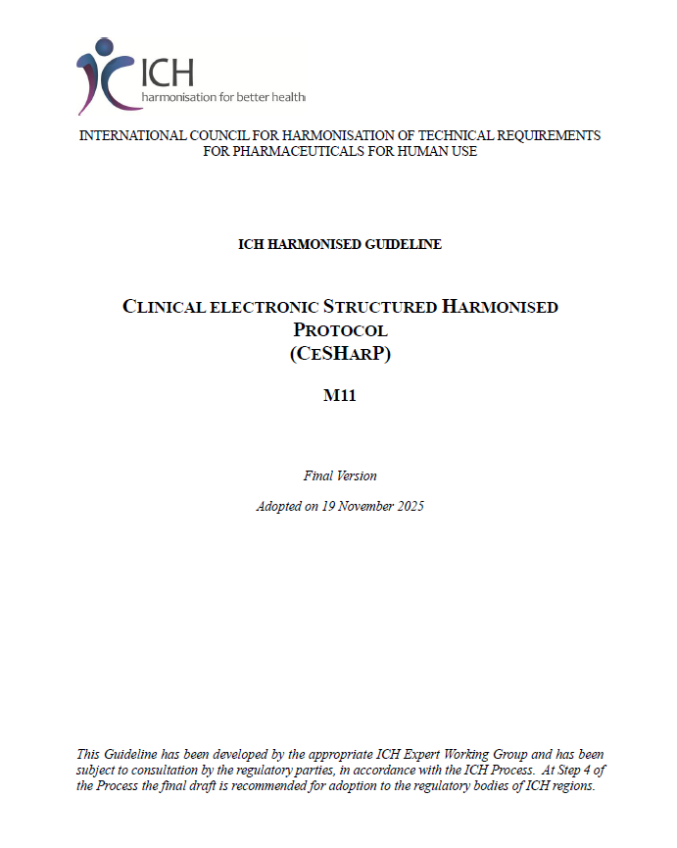
Guideline
Provides background, purpose and scope of the Protocol Template and the Technical Specification
Outlines general design principles:
  Introduce structured content, where possible
  Use established terms / definitions
  Use cross-referencing
  Avoid unnecessary duplication of content
  Avoid multiple different terms

Slide 8
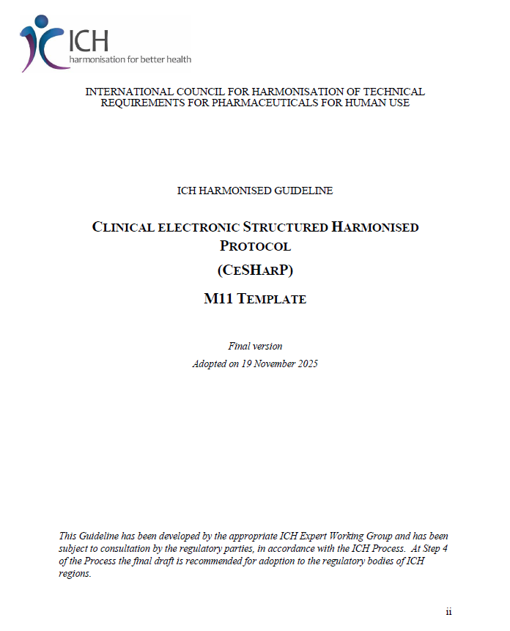
Protocol Template
Principles for Development:
  Build common core content
  Serve the needs of different stakeholders
  Define content for electronic exchange
  Design for content re-use
  Maintain flexibility

Slide 9
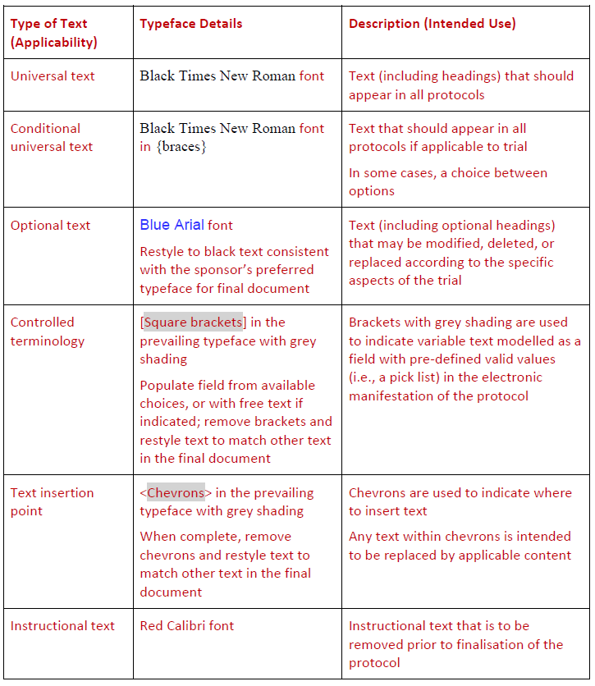
Using the Protocol Template
Preamble to the table of contents that outlines:
  Template conventions
  General header & structure guidance
  Explanation of word usage

Slide 10
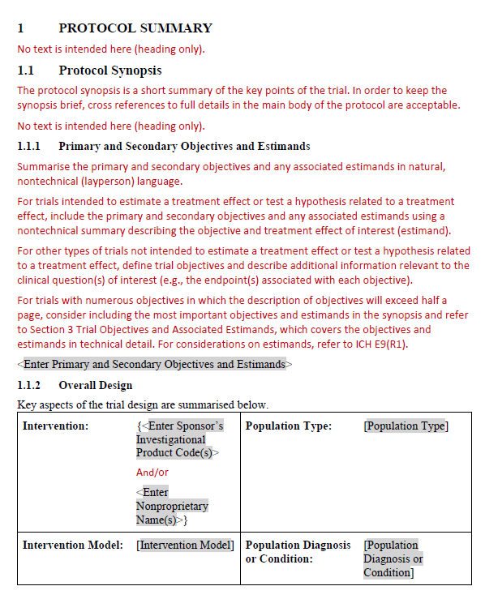
Using the Protocol Template
Universal Heading
Instructional Text
ICH Controlled Terminology*
* List of M11 terminologies can be found at: https://www.cdisc.org/standards/terminology/cdisc-ich

Slide 11
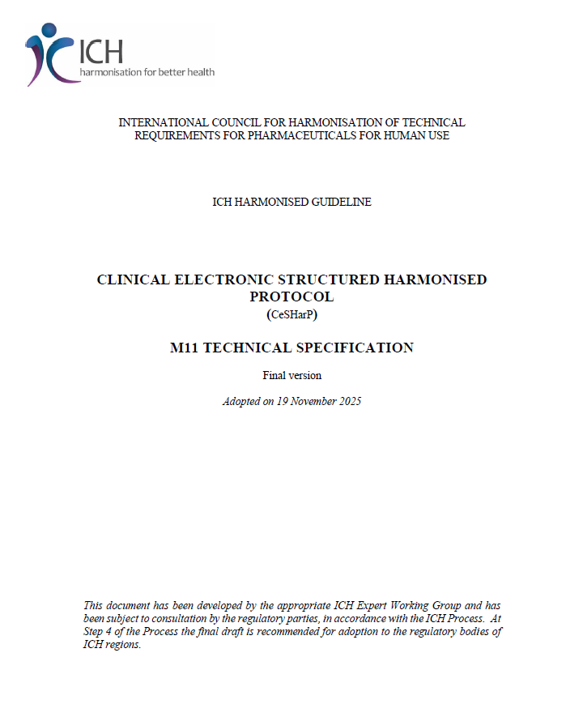
Technical Specification
Principles for Development:
  Outlines business requirements and common structured protocol content components – the data and metadata.
  Provides conformance, cardinality, and other technical attributes that enable the electronic exchange of protocol content.

Slide 12
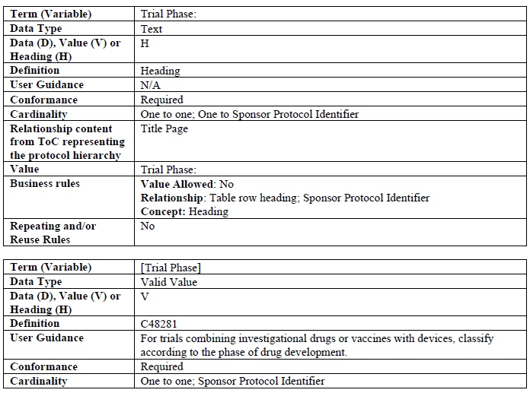
Technical Specification
The Technical Specification includes:
  Business rules as established in the Template
  Detailed descriptions of the structured content components
  Specific data fields
  Blocks of text-based content
  Other defining attributes

Slide 13
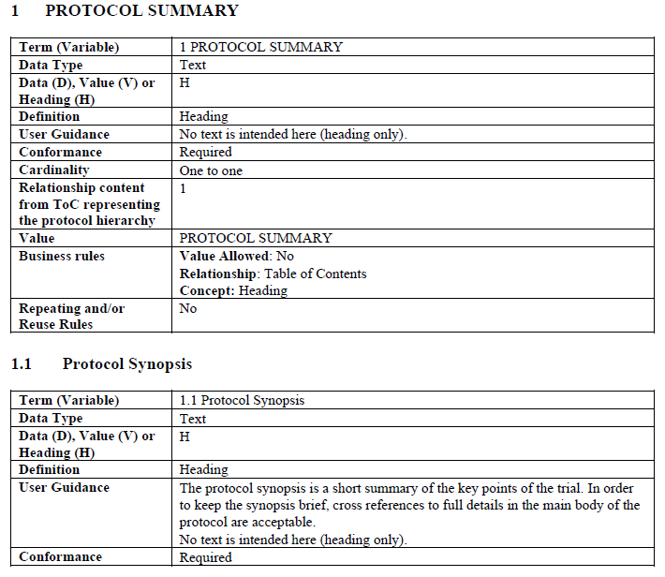
Reading the Technical Specification

Slide 14
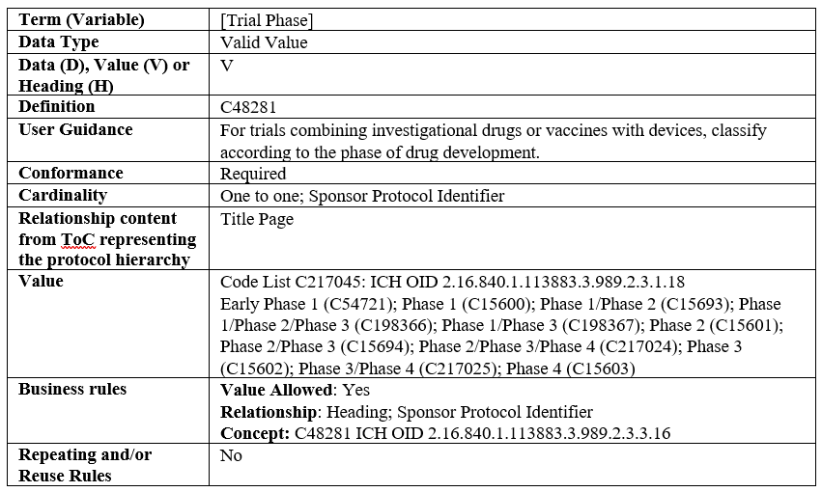
Using the Valid Value List
Data Type = “Valid Value”
List of acceptable “Values” for this data field

Slide 15
Conclusions
ICH M11 provides a standardised framework for harmonised clinical trial protocols to improve protocol quality and reduce ambiguity.
ICH M11 provides common data standards, including controlled terminology, and a structured template that enable consistent protocol development across regions and sponsors.
Implementation of ICH M11 is expected to streamline regulatory review processes and accelerate study start-up timelines. Structured protocols in machine-readable formats facilitate automated consistency checks and enable reviewers to more efficiently assess key protocol elements.
ICH M11 represents a critical step toward digital transformation in clinical research, enabling better connectivity between protocol design, study execution, and data analysis. This harmonised approach supports the broader vision of modernized, data-driven clinical trials.

Slide 16
Contact
For any questions please contact the ICH Secretariat:
admin@ich.org

